Slide 1
Measures and calculated
columns
Measures and calculated
columns

Slide 2
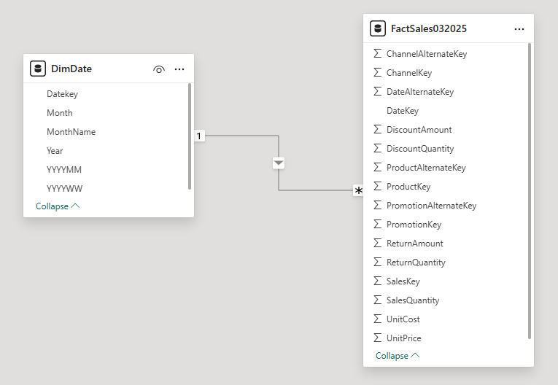
Measures and columns calculated
Note: This lab uses the FactSales032025.csv and DimDate.csv tables from resources \ CSVSources to demonstrate the difference between creating a calculated column and a measure.

Slide 3
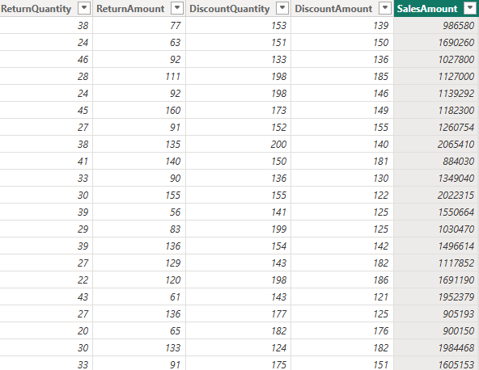
Measures and calculated columns
Create a column called SalesAmount = FactSales[ SalesQuantity ]*FactSales[ UnitPrice ]

Slide 4

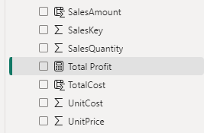
Measures and columns calculated
Create also TotalProfit measure at the FactSales table level that calculates total profit:
Total Profit = SUM ( FactSales[ SalesAmount ] ) - SUMX ( FactSales , FactSales [ SalesQuantity ] * FactSales[ UnitCost ] )
Note the difference in using the SUM and SUMX functions to aggregate data.

Slide 5
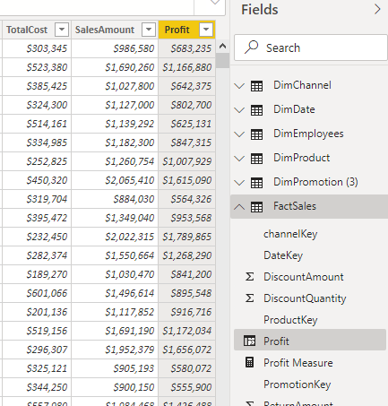
Measures and columns calculated
Note that the measure only takes into account aggregations. For example
Total Profit = SUM (FactSales[ SalesAmount ]) - SUMX ( FactSales,FactSales [ SalesQuantity ]*FactSales[ UnitCost ])

Slide 6
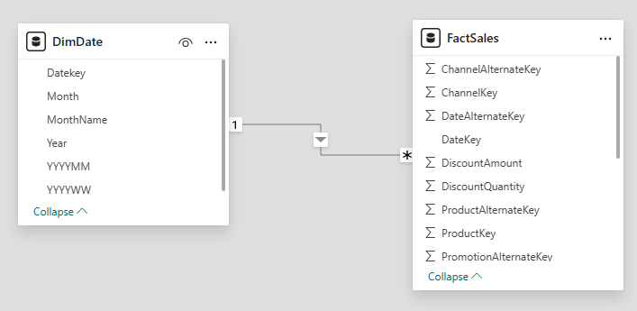
Measures and columns calculated
Note that the measure does not appear like the calculated column because the scope differs in the two cases.
Add the DimDate dimension from the DimDate.csv file and check the relationship between DimDate and FactSales

Slide 7
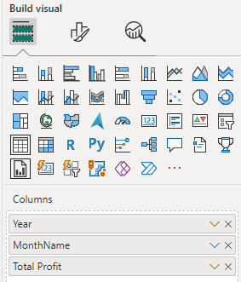
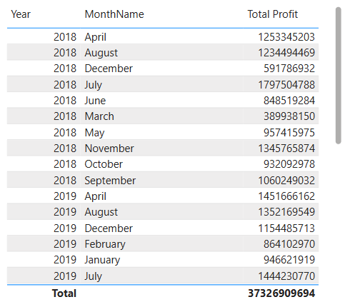
Measures and columns calculated
Go back to the scene, add a Table type visualization and add Year and MonthName respectively as well as Total Profit in the Columns parameter and observe the visualization change.

Slide 8
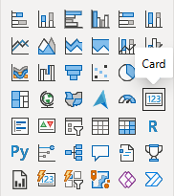
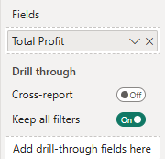
Measures and columns calculated
Add a Card visual and drag the Total Amount measurement at the Fields

Slide 9
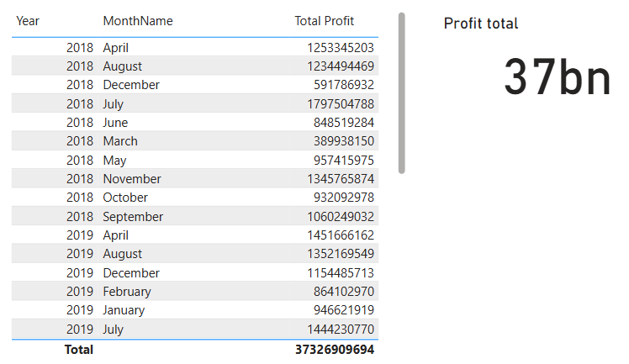
Measures and columns calculated
Observe the result

Slide 10
Thank you
Thank you

